Slide 1
Cloud Computing :
Break Down the Techniques
Yeh-Ching Chung

Slide 2
Outline
Introduction to Cloud Computing
Techniques & Case Studies
  Infrastructure as a Service
  Platform as a Service
  Software as a Service
Summary

Slide 3
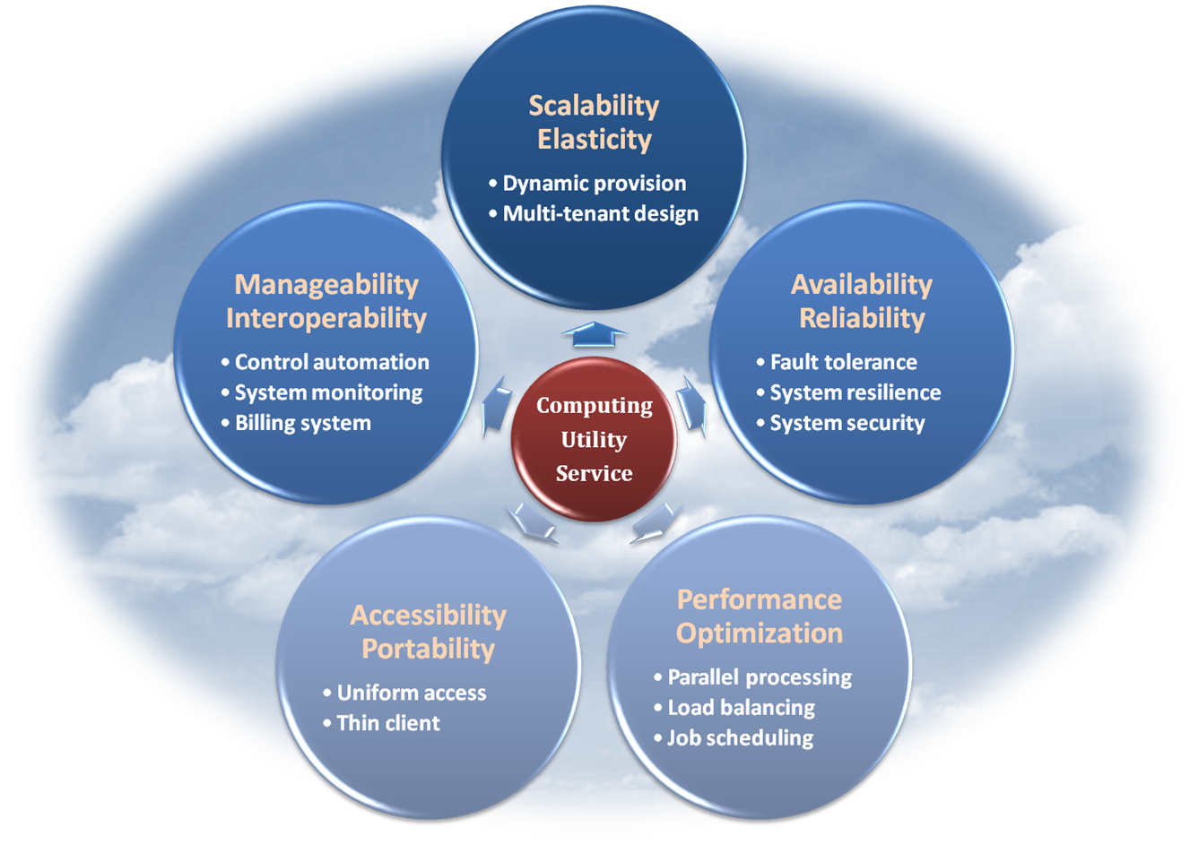
In Our Humble Opinion
Cloud computing is a paradigm shift of computing, a new way of thinking about IT industry but not any specific technology.
  Central ideas
    Computing
    Utility
    Service
  Enabling techniques
    Hardware virtualization
    Parallelized and distributed
    computing
    Web service
  Properties and Characteristics

Slide 4





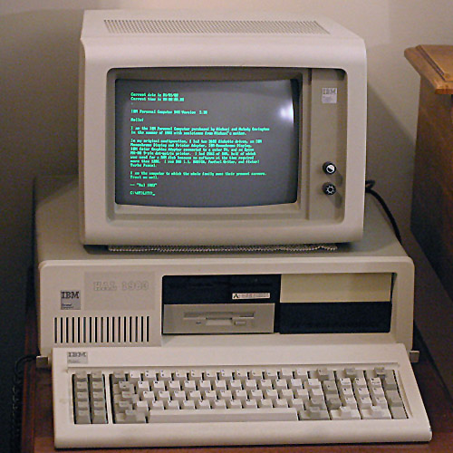


Long divided, must unite; long united, must divide.
Water pond
Carry bucket
Small bottle
Drinking fountain
Past
Now
Mainframe
PC
Laptop & Mobile
Cloud Computing

Slide 5
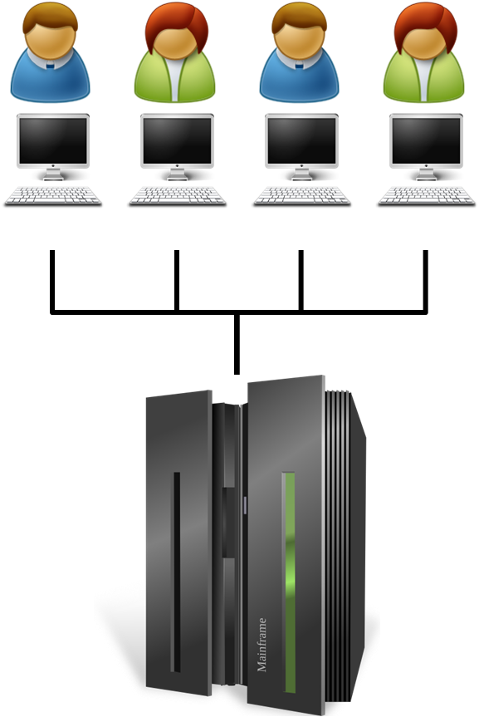
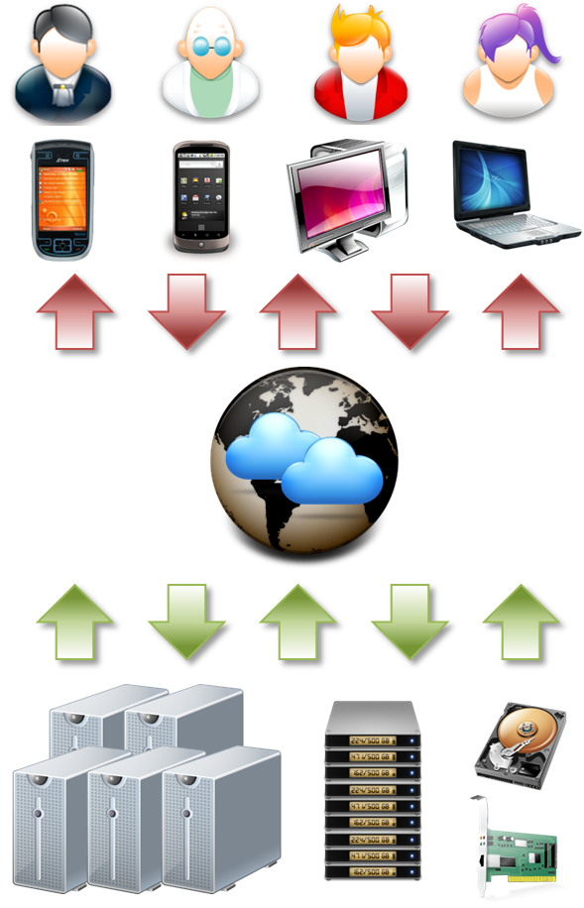
Hardware
Mainframe
Cloud Computing

Slide 6
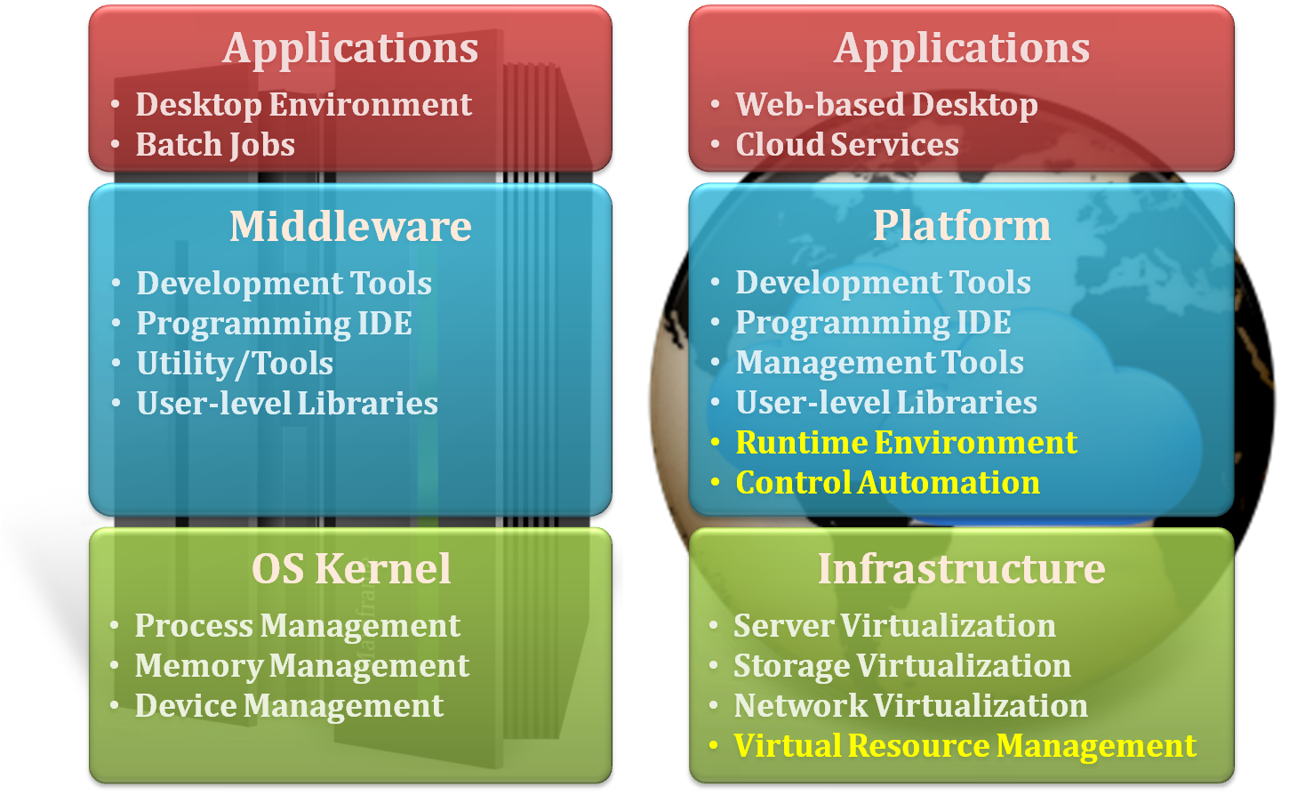
Software Stack
Mainframe
Cloud Computing

Slide 7
Dissimilarity
 | Mainframe | Cloud Computing
Client Interface | Terminals | Variety of user interfaces
Interconnection | Bus architecture | Broadband network
Service | Application only | IaaS, PaaS, SaaS
Architecture | Single machine | Consolidation of resources
Elasticity | Stand alone | Rapidly shrink and spread

Slide 8
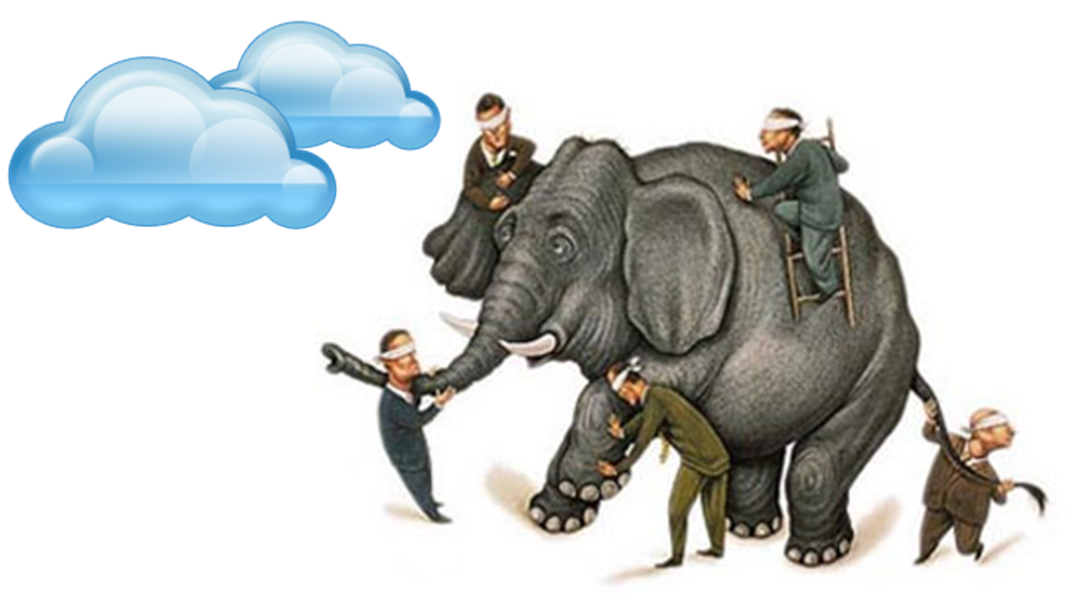
Cloud computing inside
Techniques & Case Studies

Slide 9
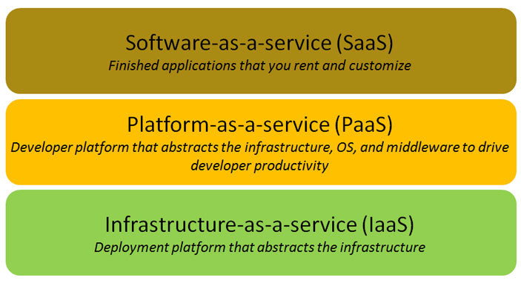
Cloud Service Model : Overview
Software as a Service (SaaS)
  Turn-key software hosted on the cloud and accessible through the browser
  live in a hotel
Platform as a Service (PaaS)
  An operating platform including application-specific libraries and runtime environment
  buy an empty house
Infrastructure as a Service (IaaS)
  A virtualized computer infrastructure with computing server, storage space and external network bandwidth
  build a new house

Slide 10
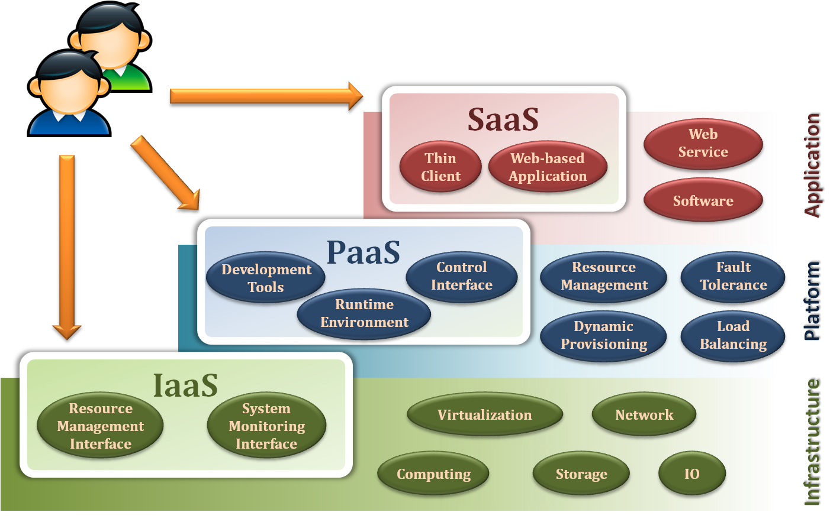
Cloud Service Model : Looking Inside

Slide 11
IaaS
Infrastructure as a Service
  build a new house

Slide 12
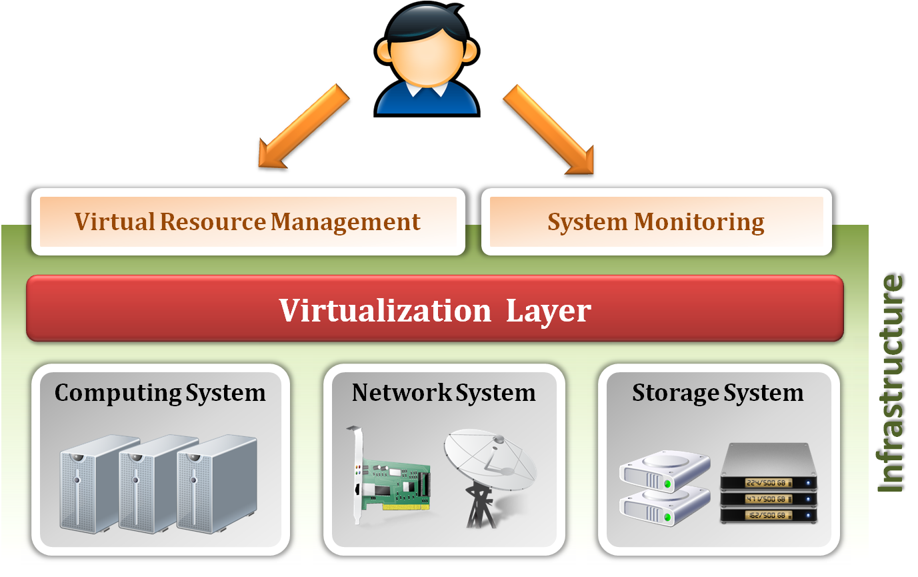
IaaS : Infrastructure as a Service
Infrastructure as a Service (IaaS) delivers computer infrastructure for cloud user, typically a platform virtualization environment as a service.
Examples:
  Amazon EC2
  Eucalyptus
  OpenNebula
  etc.

Slide 13
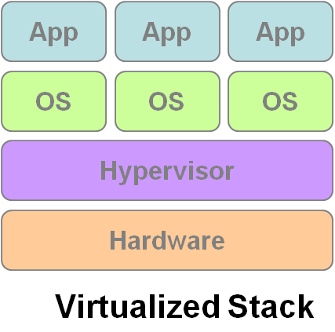
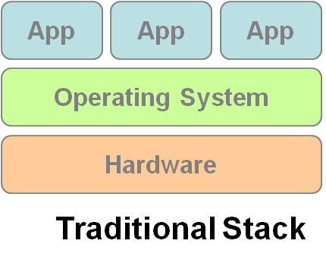
IaaS : Enabling Techniques
Virtualization is an abstraction of logical resources away from underlying physical resources
Virtualization technique shifts OS onto hypervisor.
Multiple OSes share the physical hardware and provide different services.
Improve utilization, availability, elasticity and manageability.
VM1
VM2
VM3

Slide 14
IaaS: Provide Services
Virtual Resource Management
    Virtual Machine: provide the basic virtual machine operations, such as creation, suspension, resumption, termination, …etc.
    Virtual Storage: provide the basic virtual storage operations, such as
    space allocation, space release, data writing, data reading, …etc.
    Virtual Network: provide the basic virtual network operations, such as
    IP address allocation, domain name register, connection establishment, …etc.
System Monitoring
    Virtual Machine: monitor the system status of each virtual machine, such as CPU loading, memory utilization, IO loading, …etc.
    Virtual Storage: monitor the storage status of each virtual storage, such as virtual space utilization, data duplication, storage device access bandwidth, …etc.
    Virtual Network: monitor the network status of each virtual network, such as virtual network bandwidth, network connectivity , network load balancing, …etc.

Slide 15
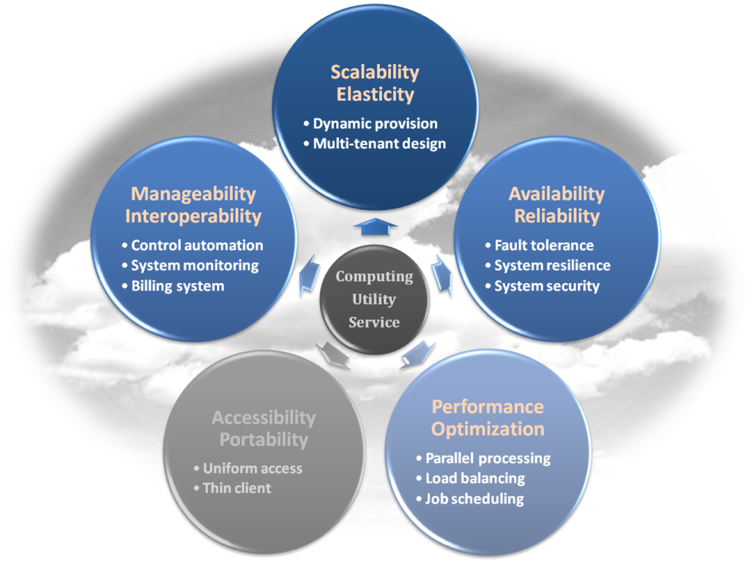
Properties & Characteristics
Elasticity
  Rapidly provision the amount of infrastructure resources on demand
Availability
  Guarantee the infrastructure resources are available without worrying about the possibility of hardware failure
Manageability
  Manage virtualized resources by means of automatic
  system control and monitor process
Optimization
  Optimize the resource deployment to improve
  the utilization among physical resources and
  virtualized resources

Slide 16

IaaS
Breakdown the technique

Slide 17
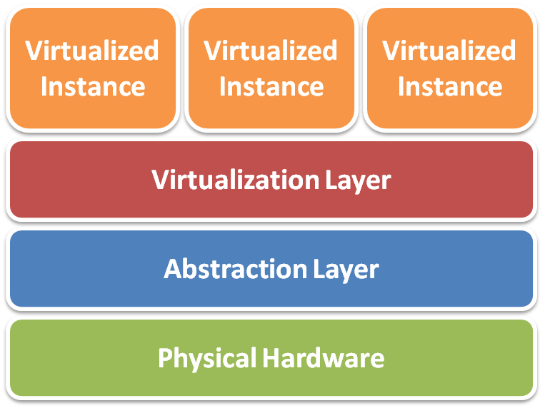
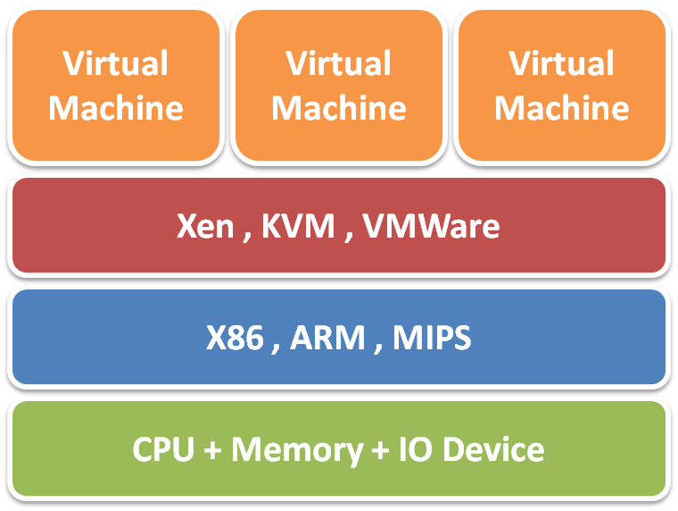
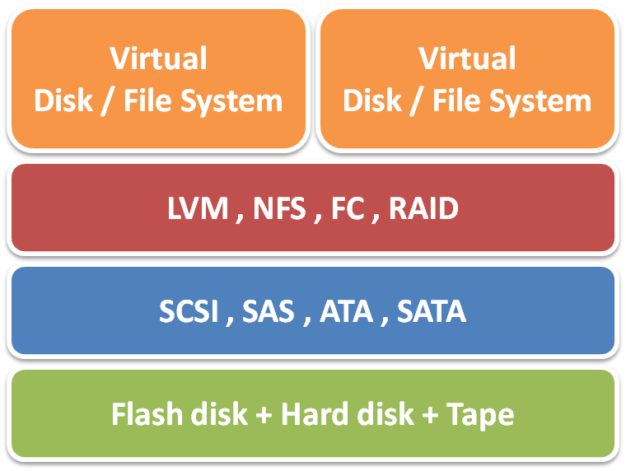
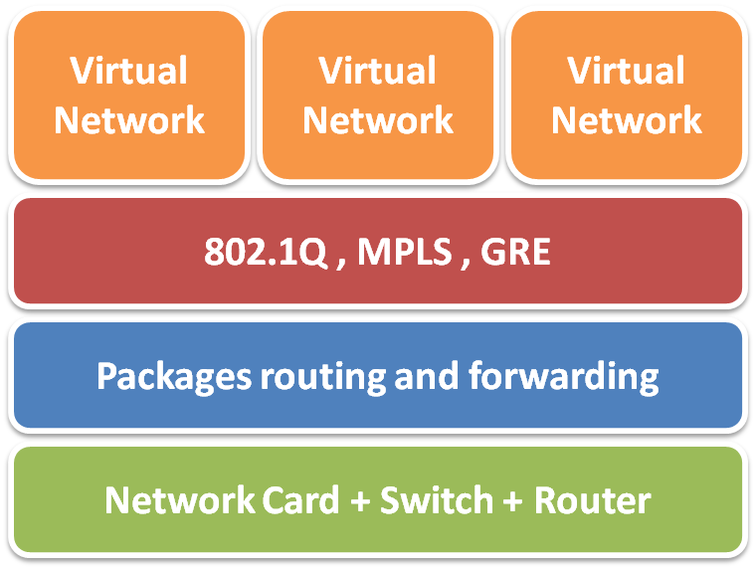
IaaS : Resource Virtualization
Server Virtualization
Storage Virtualization
Network Virtualization

Slide 18
IaaS : Virtual Machine Monitor
What’s Virtual Machine Monitor (VMM) ?
  VMM or Hypervisor is the software layer providing the virtualization
Virtualization Approaches :
  Full-Virtualization
    VMM simulates enough hardware to allow an unmodified guest OS.
  Para-Virtualization
    VMM does not necessarily simulate hardware, but instead offers a special API that can only be used by the modified guest OS.

Slide 19
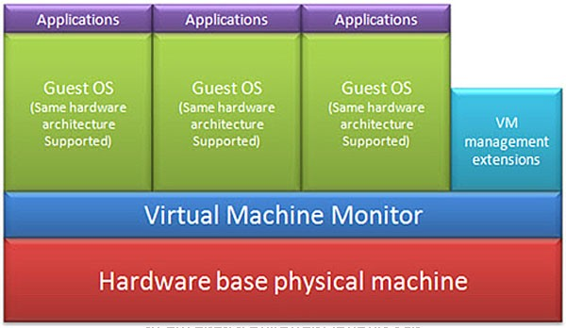
IaaS : Full Virtualization
Pros | Not need to modify the guest OS
Cons | Significant performance hit

Slide 20
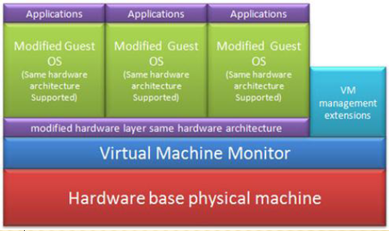
IaaS : Para Virtualization
Pros | Light weight and high performance
Cons | Require to modify the guest OS

Slide 21
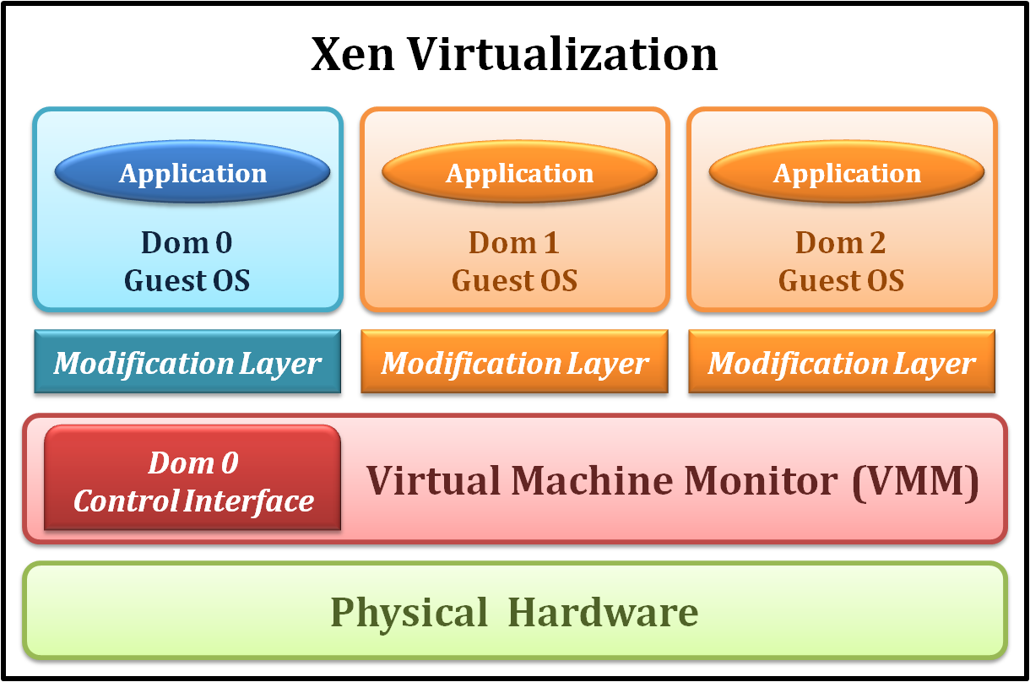
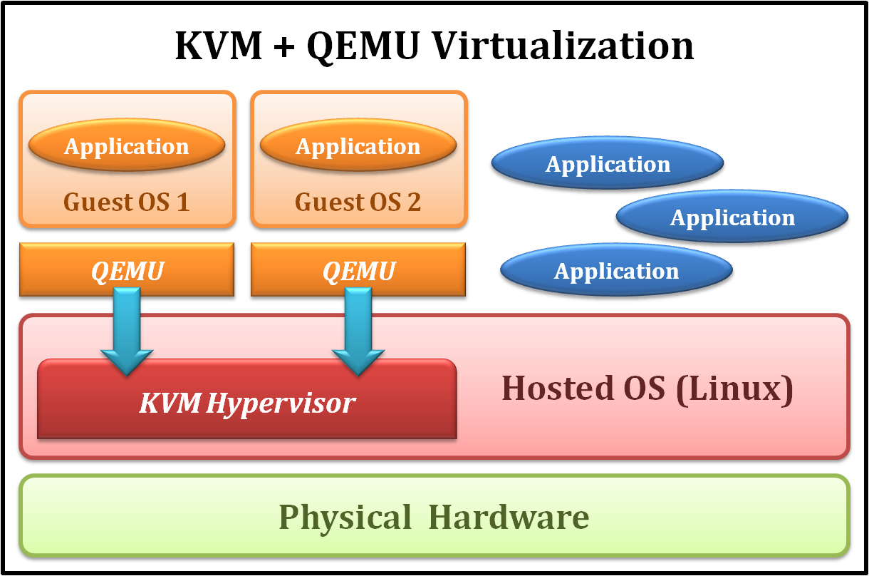
IaaS : Xen vs. KVM + QEMU
Xen
KVM + QEMU
Para Virtualization
Bare metal
Dom0 acts as a administration role
Full Virtualization
Implemented as Linux kernel module
Work with QEMU emulator

Slide 22
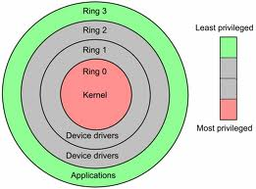
IaaS : Server Virtualization – CPU Virtualization
Modern CPU status is usually classified as several modes.
In general, we conceptually divide them into two modes :
  Kernel mode (Ring 0)
    CPU may perform any operation allowed by its architecture, including any instruction execution, IO operation, area of memory access, and so on.
    Traditional OS kernel runs in Ring 0 mode.
  User mode (Ring 1 ~ 3)
    CPU can typically only execute a subset of those available instructions in kernel mode.
    Traditional application runs in Ring 3 mode.

Slide 23
IaaS : Server Virtualization – CPU Virtualization
By the classification of CPU modes, we divide instructions into following types :
  Privileged instruction
    Those instructions that trap if the machine is in user mode and do not trap if the machine is in kernel mode.
  Sensitive instructions
    Those instructions that interact with hardware, which include control-sensitive and behavior-sensitive instructions.
  Innocuous instruction
    All other instructions.
  Critical instruction
    Those sensitive but not privileged instructions.

Slide 24
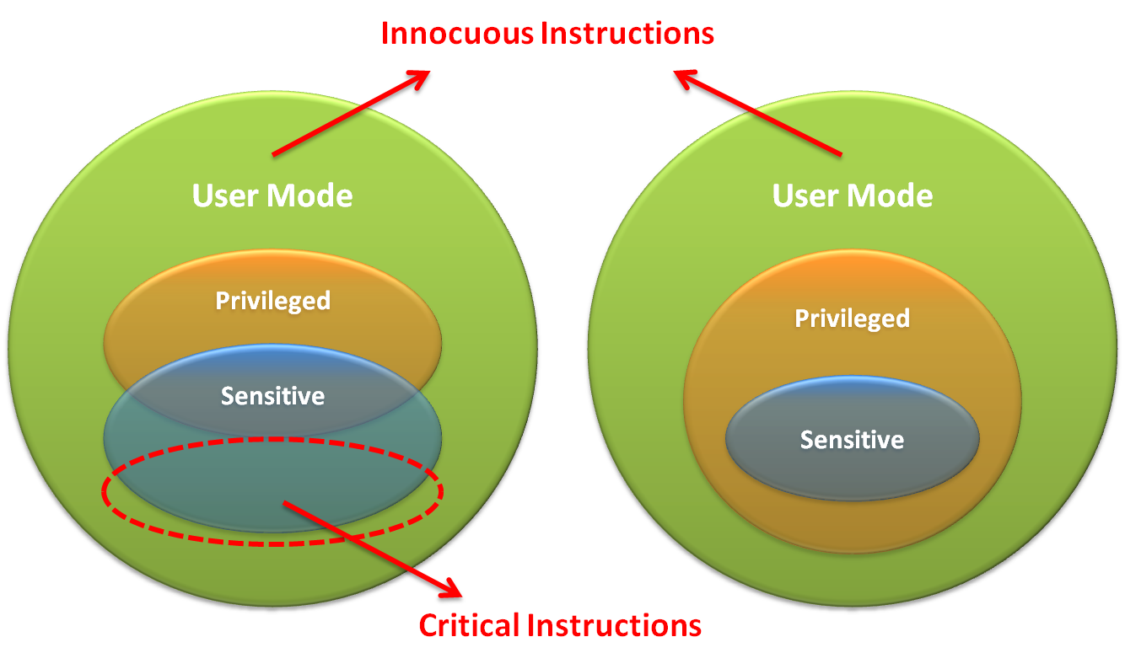
IaaS : Server Virtualization – CPU Virtualization

Slide 25
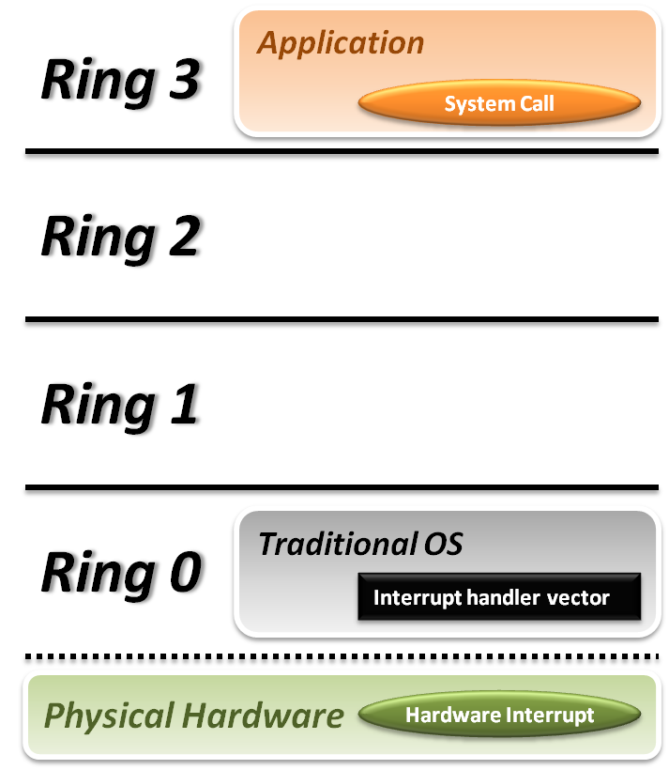


IaaS : Server Virtualization – CPU Virtualization
Traditional OS :
  When application invoke a system call :
    CPU will trap to interrupt handler vector in OS.
    CPU will switch to kernel mode (Ring 0) and execute OS instructions.
  When hardware event :
    Hardware will interrupt CPU execution, and jump to interrupt handler in OS.

Slide 26
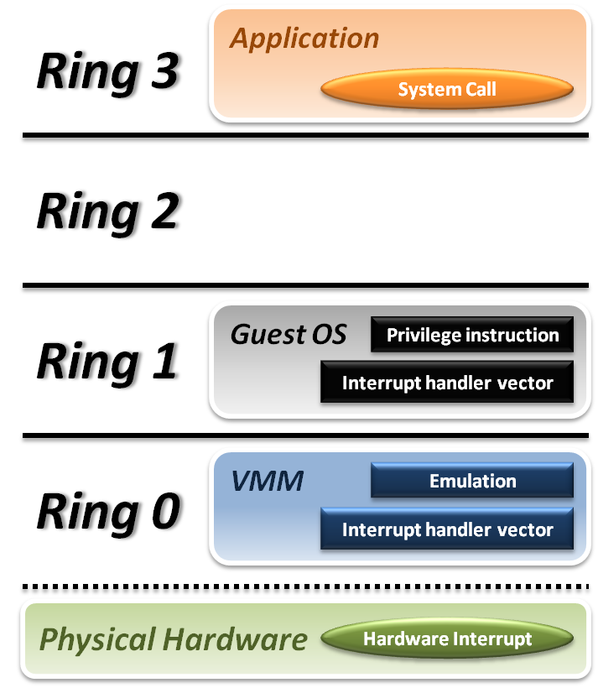






IaaS : Server Virtualization – CPU Virtualization
VMM and Guest OS :
  System Call
    CPU will trap to interrupt handler vector of VMM.
    VMM jump back into guest OS.
  Hardware Interrupt
    Hardware make CPU trap to interrupt handler of VMM.
    VMM jump to corresponding interrupt handler of guest OS.
  Privilege Instruction
    Running privilege instructions
    in guest OS will be trapped to VMM for instruction emulation.
    After emulation, VMM jump back to guest OS.

Slide 27
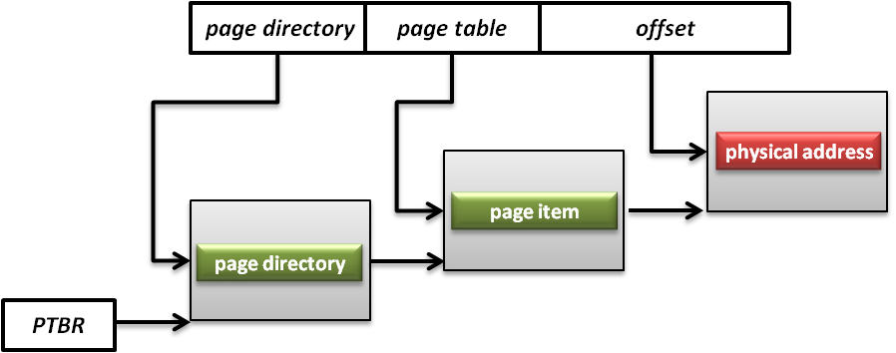
IaaS : Server Virtualization – Memory Virtualization
Memory Management Unit (MMU)
  What is MMU ?
    A computer hardware component responsible for handling accesses to memory requested by the CPU.
    Its functions include translation of virtual addresses to physical addresses, memory protection, cache control, bus arbitration and etc.
  What is PTBR ?
    Page Table Base Register (PTBR) is a register point to the base of page table for MMU.

Slide 28
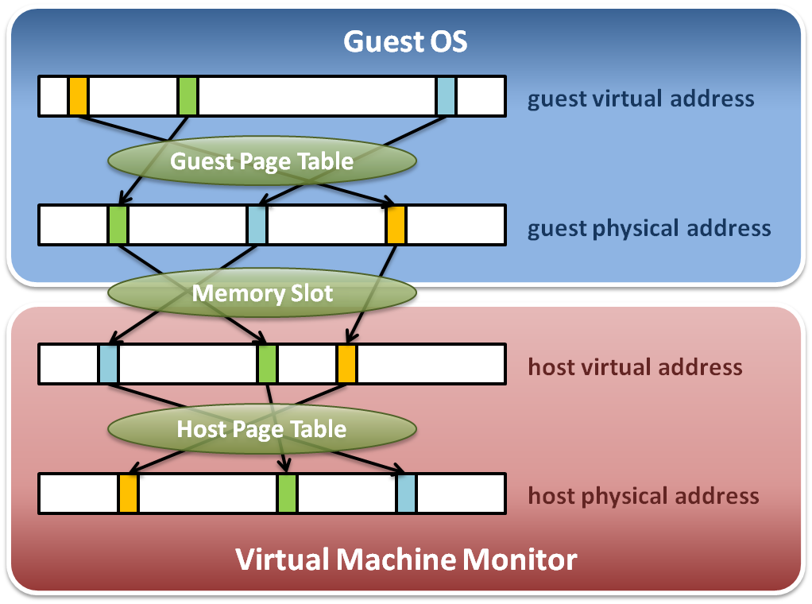
IaaS : Server Virtualization – Memory Virtualization
Memory virtualization architecture

Slide 29
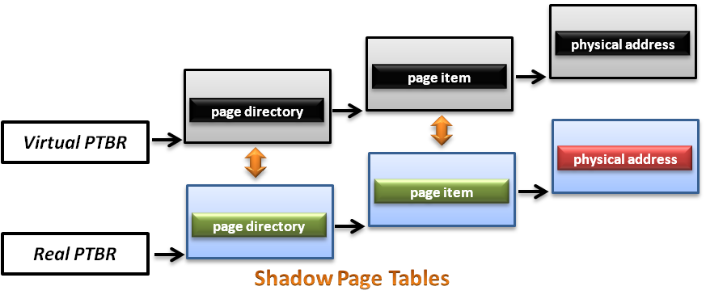
IaaS : Server Virtualization – Memory Virtualization
How does Shadow Page Tables work ?
  VMM should make MMU virtualized
    VMM manages the real PTBR and a virtual PTBR for each VM
    When guest OS is activated, the real PTBR points to a shadow page table
    When guest OS attempts to modify the PTBR, it will be intercepted by VMM for further emulation

Slide 30
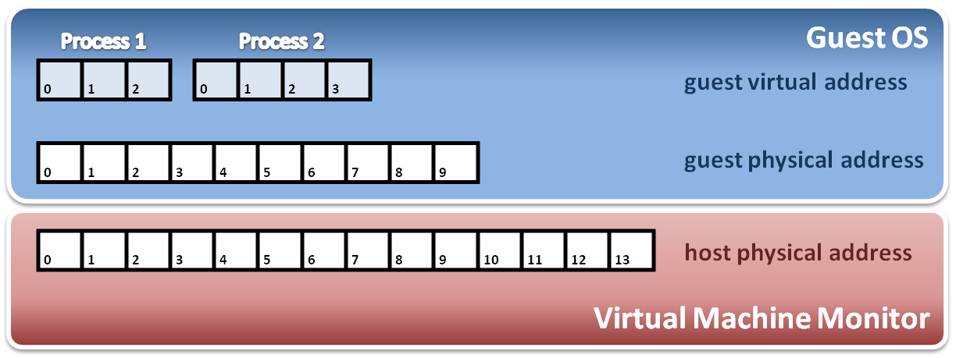
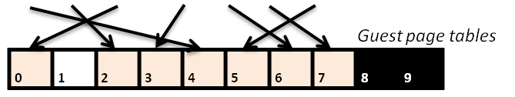
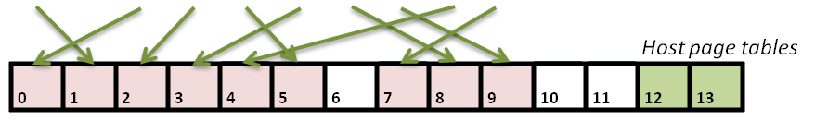
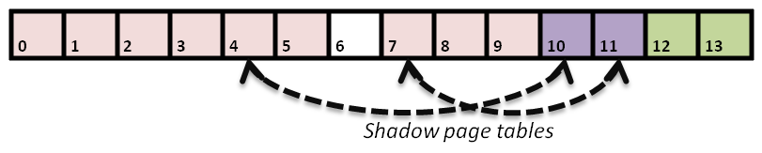
IaaS : Server Virtualization – Memory Virtualization
Construct shadow page table
  Guest OS will maintain its own page table for each process.
  VMM map each guest physical page to host physical page.
  Create shadow page tables for each guest page table.
  VMM should protect host frame which contains guest page table.
Write protection

Slide 31
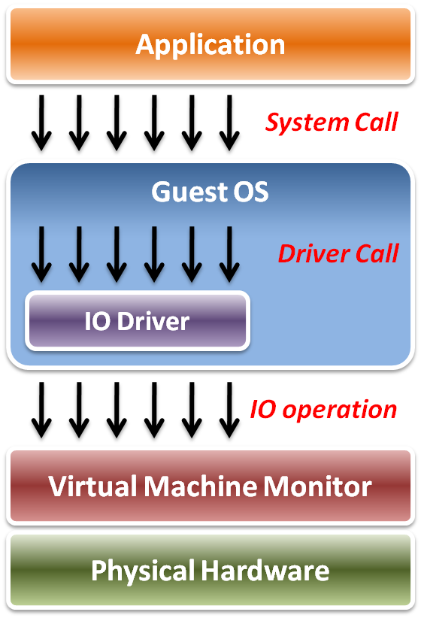
IaaS : Server Virtualization – IO Virtualization
Implementation Layers :
  System call
    The interface between applications and guest OS.
  Driver call
    The interface between guest OS and IO device drivers.
  IO operation
    The interface between IO device driver of guest OS and virtualized hardware ( in VMM ).

Slide 32
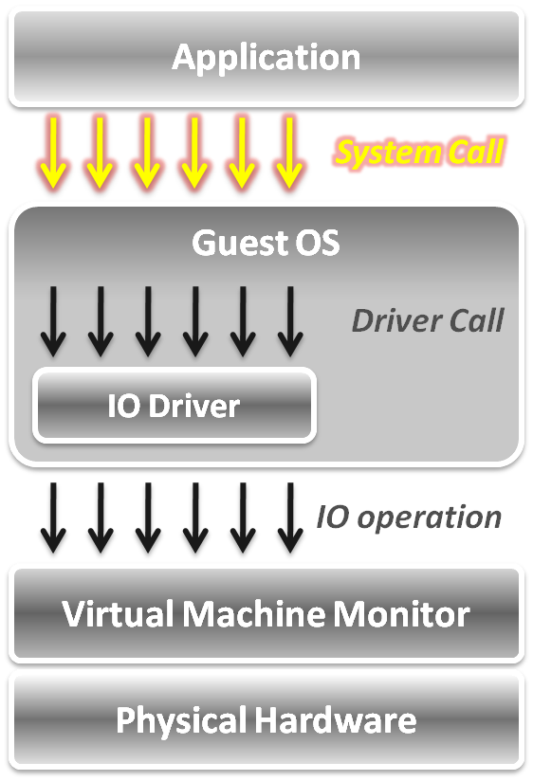
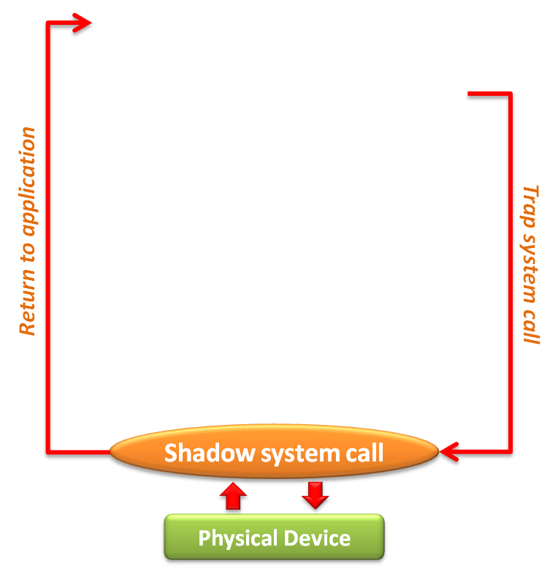
IaaS : Server Virtualization – IO Virtualization
In system call level :
  When application invoke a system call, system will trap to VMM first.
  VMM intercepts system calls, and maintains shadowed IO system call routines to simulate functionalities.
  After simulation, VMM directly return to application in gust OS.

Slide 33
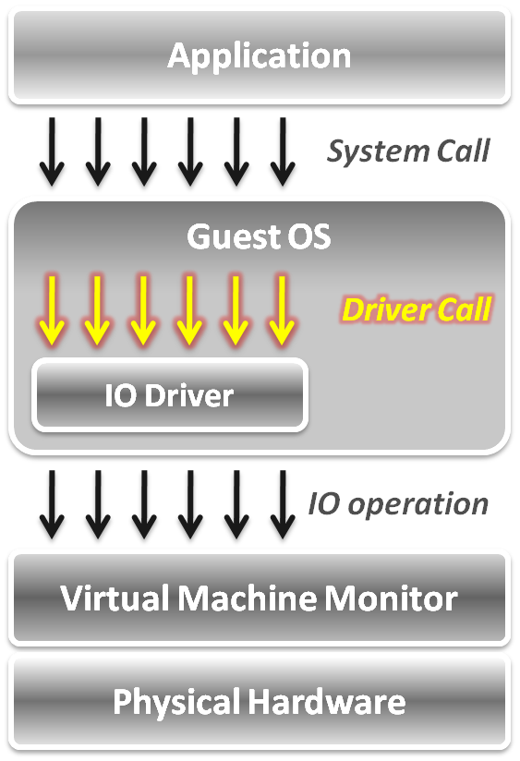
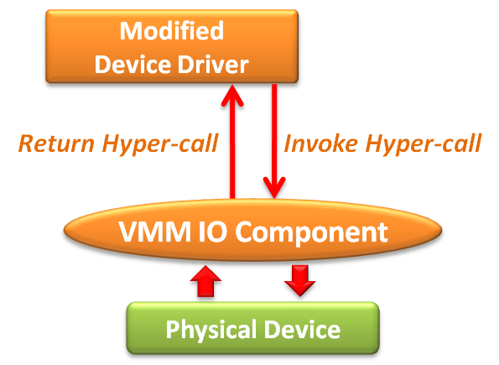
IaaS : Server Virtualization – IO Virtualization
In device driver call level :
  Utilize para-virtualization technique, which means the IO device driver in guest OS should be modified.
  The IO operation is invoked by means of hyper-call between the modified device driver and VMM IO component.

Slide 34
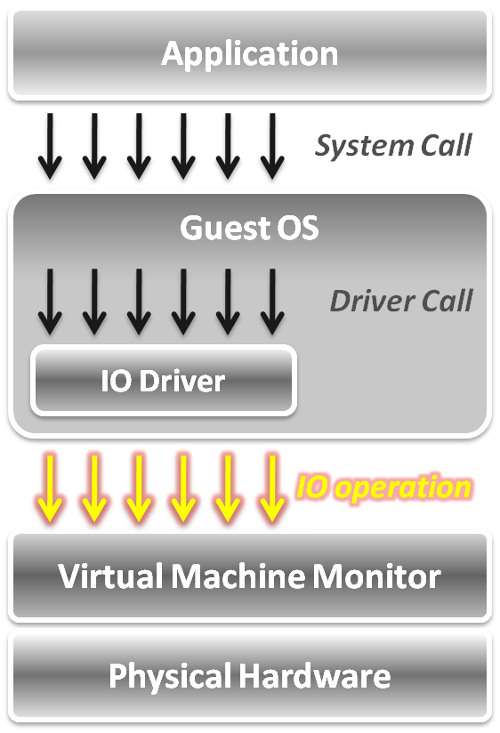
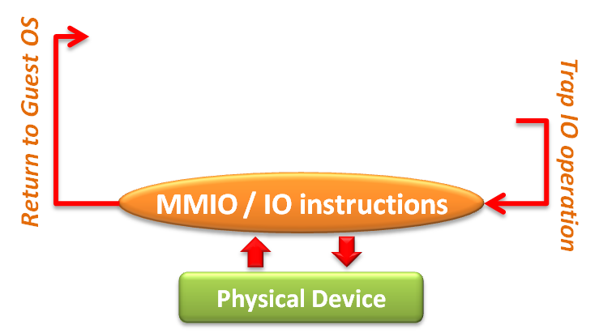
IaaS : Server Virtualization – IO Virtualization
In IO operation level,
two approaches :
  Memory mapped IO
    Loads/stores to specific region of real memory are interpreted as command to devices.
    The memory mapped IO region is protected.
  Port mapped IO
    Special input/output instructions with special addresses.
    The IO instructions are privileged.
Due to the privileged nature, these IO operations will be trapped to the VMM.

Slide 35
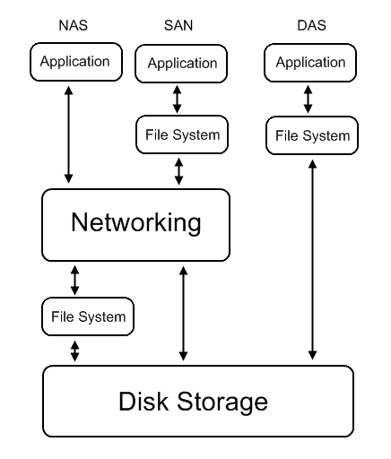
IaaS : Storage Virtualization
Common storage architecture :
  DAS - Direct Attached Storage
    Storage device was directly attached to a server or workstation, without a storage network in between.
  NAS - Network Attached Storage
    File-level computer data storage connected to a computer network providing data access to heterogeneous clients.
  SAN - Storage Area Network
    Attach remote storage devices to servers in such a way that the devices appear as locally attached to the operating system.

Slide 36
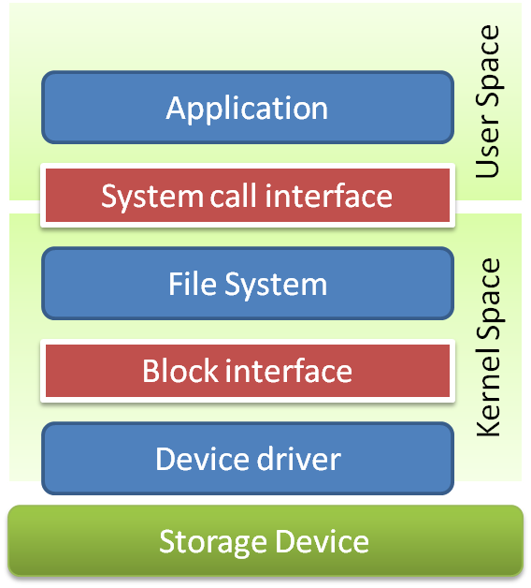
IaaS : Storage Virtualization
Layers can be virtualized
  File system
    Provide compatible system call interface to user space applications.
  Block device
    Provide compatible block device interface to file system.
    Through the interface such as SCIS, SAS, ATA, SATA, etc.

Slide 37
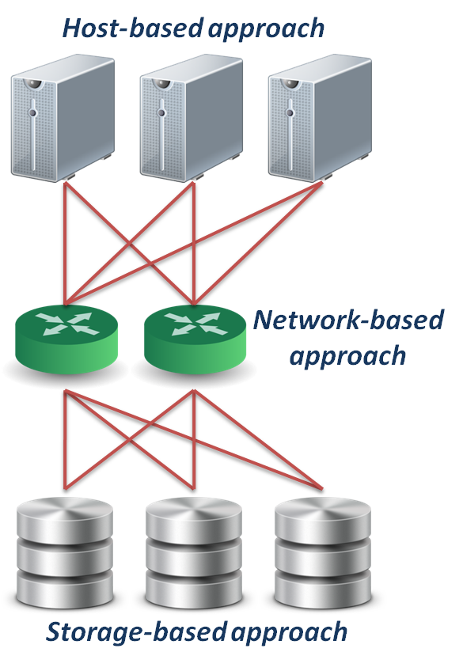
IaaS : Storage Virtualization
Different approaches :
  Host-based approach
    Implemented as a software running on host systems.
  Network-based approach
    Implemented on network devices.
  Storage-based approach
    Implemented on storage target subsystem.

Slide 38


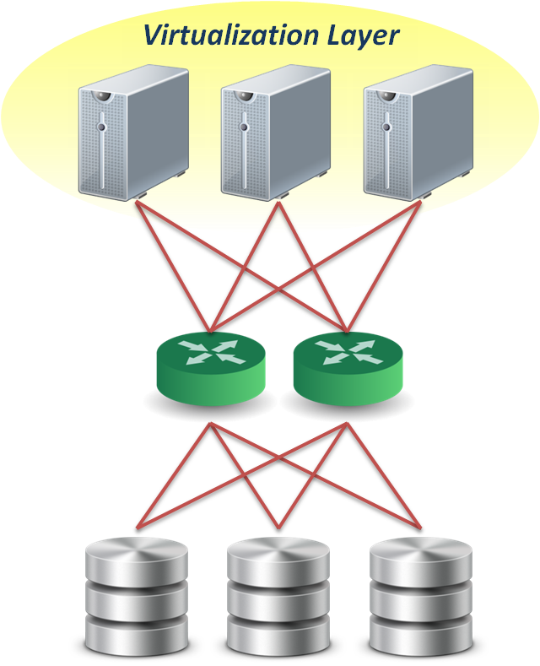
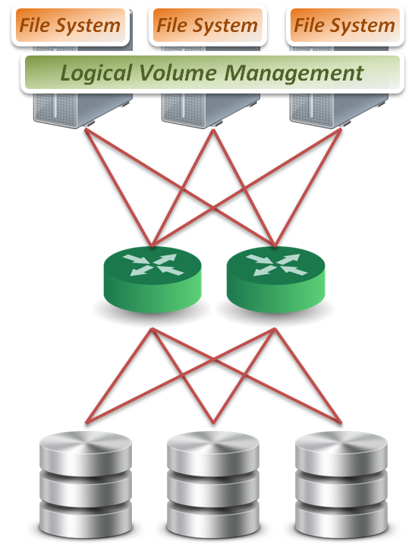
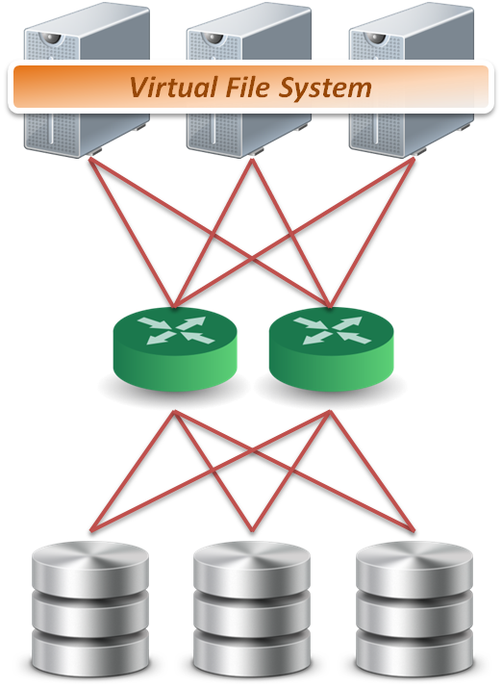

IaaS : Storage Virtualization
Host-based approach
  File level
    Run virtualized file system on the host to map files into data blocks, which distributed among several storage devices.
  Block level
    Run logical volume management software on the host to intercept I/O requests and redirect them to storage devices.
  Provide services
    Software RAID
Block 1
Block 2
Block 1
Block 2
Block 1
Sub-file
1
Sub-file
2
Sub-file
3

Slide 39

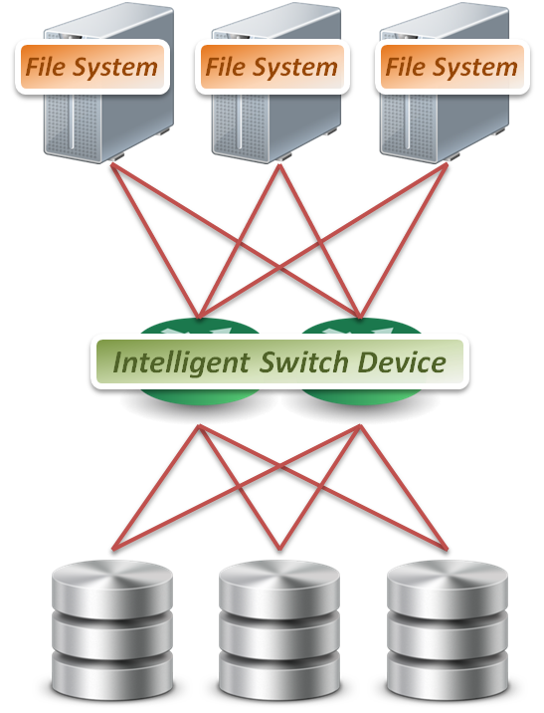
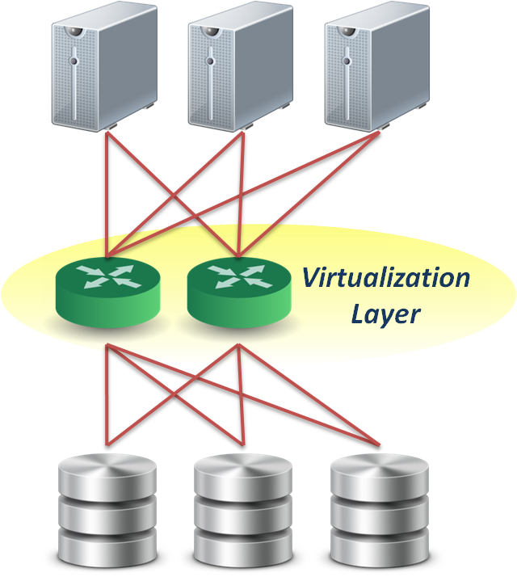
IaaS : Storage Virtualization
Network-based approach
  File level
    Seldom implement file level virtualization on network device.
  Block level
    Run software on dedicated appliances or intelligent
    switches and routers.
  Provide services
    Multi-path
    Storage pooling
Block 1
Block 2
Block 1
Block 2
Block 1

Slide 40

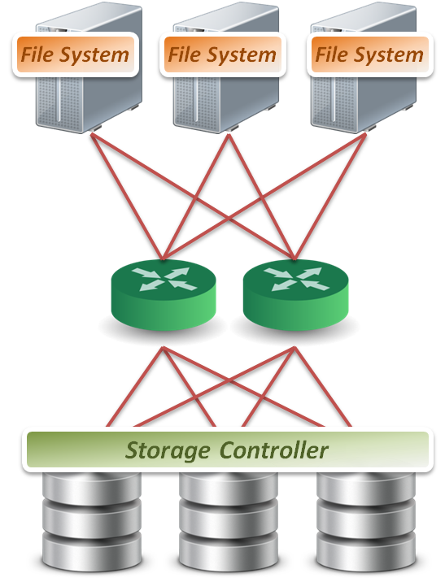
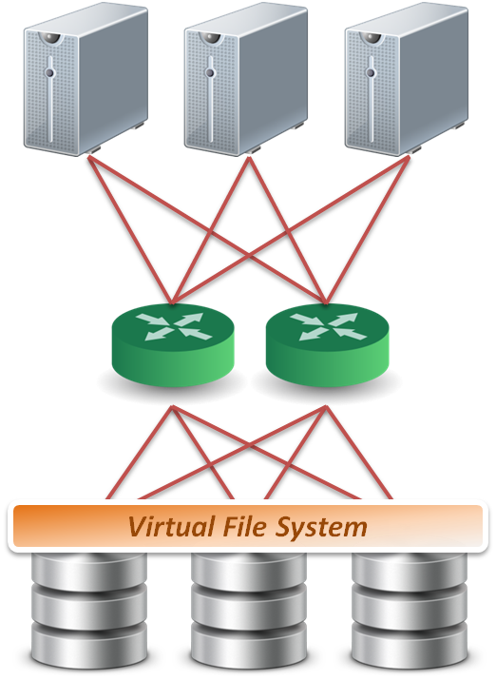
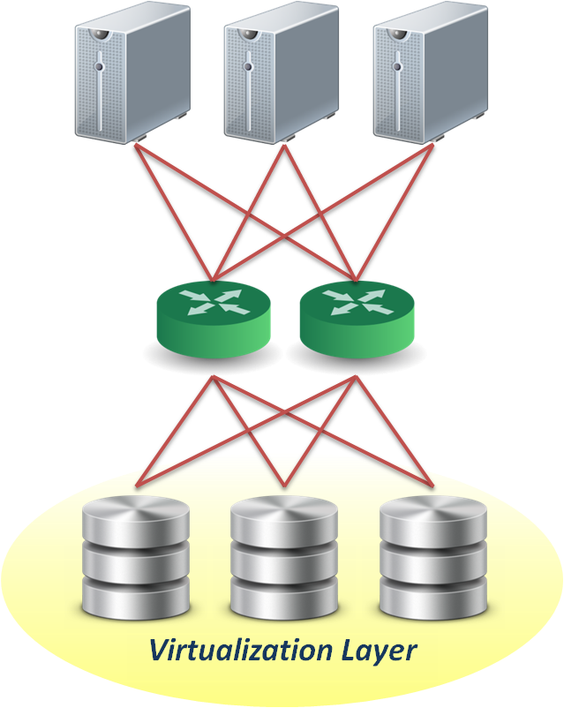
IaaS : Storage Virtualization
Storage-based approach
  File level
    Run software on storage device to provide file based data storage services to host through network.
  Block level
    Embeds the technology in the target storage devices.
  Provide services
    Storage pooling
    Replication and RAID
    Data sharing and tiering
Block 1
Block 1
Block 1
Replica
Replica
Replica
Block 1
Block 1
Block 1
Sub-file
1
Sub-file
1.bak
Sub-file
2
Sub-file
2.bak
Sub-file
3

Slide 41
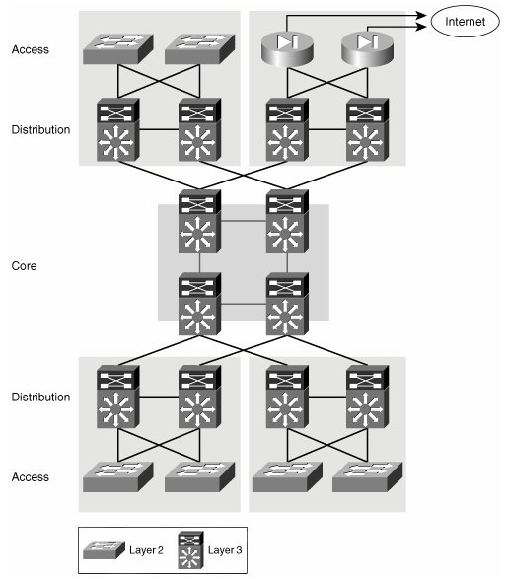
IaaS : Network Virtualization
Computer Network:
  A computer network, often simply referred to as a network, is a collection of computers and devices interconnected by communications channels that facilitate communications among users and allows users to share resources.
Hierarchical approach
  Traffic is aggregated hierarchically from an access layer into a layer of distribution switches and finally onto the network core.

Slide 42


IaaS : Network Virtualization
Two categories :
  External network virtualization (External NV)
    Combining many networks, or parts of networks, into a virtual unit.
  Internal network virtualization (Internal NV)
    Providing network-like functionality to the software containers on a single system.
External Network Virtualization
Internal Network Virtualization

Slide 43


IaaS : Network Virtualization – External NV
Layer 2 solution
  Divide physical switch into multiple logical switches.
Layer 3 solution 3
  VRF technique
  ( Virtual Routing and Forwarding )
  Emulate isolated routing tables within one physical router.

Slide 44
IaaS : Network Virtualization – Internal NV
Traditional approach :
  Work with TUN/TAP and Linux Bridge :
    Virtual machines connect to host by a virtual network adapter, which is implemented by TUN/TAP driver.
    Virtual adapters will connect to Linux bridges, which play the role of virtual switch.
Advanced approach :
  Open vSwitch porject :
    A vSwitch is a pure software based Layer 2 network element that runs on the server
    The function of the vSwitch is to allow the VMs within a server to communicate with each other and to manage communications to the rest of the network.

Slide 45

IaaS : Network Virtualization – Internal NV
Linux Bridge + TUN/TAP

Slide 46

IaaS : Network Virtualization – Internal NV
vSwitch solution use case

Slide 47

IaaS : Network Virtualization – Internal NV
vSwitch with hardware support

Slide 48


IaaS : Case Study 1
Amazon EC2 ( Elastic Compute Cloud )
Amazon EC2 is a central part of Amazon.com's cloud computing platform.
Amazon EC2 allows users to rent virtual computers to run their applications.
IaaS Architecture of Amazon EC2

Slide 49
IaaS : Case Study 1
Amazon EC2 ( Elastic Compute Cloud )
User Interfaces :
  EC2 & S3 API
    Submit VM deployment and Storage requests through command line interface.
  Web Interface
    Initial system configuration through web interface.
  System Monitoring
    Monitor system status through web-based display.
Virtualization :
  Server Virtualization : Xen Hypervisor
  Network Virtualization : Elastic IP Address
  Storage Virtualization : Simple Storage System + Elastic Block Storage

Slide 50


IaaS : Case Study 2
Eucalyptus
(Elastic Utility Computing Architecture for Linking Your Programs to Useful Systems)
IaaS Architecture of Eucalyptus

Slide 51

IaaS : Case Study 2
Server Virtualization

Slide 52
IaaS : Case Study 2
Server Virtualization
System Component :
  Cloud Controller (CLC)
    Dispatch user request to some clusters.
  Cluster Controller (CC)
    Determine enough resource for virtual machine deployment.
  Node Controller (NC)
    Run user’s virtual machines.

Slide 53

IaaS : Case Study 2
Storage Virtualization

Slide 54
IaaS : Case Study 2
Storage Virtualization
Two kinds of storage systems :
  Walrus ( S3 compatible )
  Mainly store the images, which provided by users or administrator, for VMs booting.
  Storage Controller
  Mainly store user created logical volumes which can be attached to specified VMs in run-time. Each storage controller in a cluster is controlled by the corresponding cluster controller, and each VM can utilize these logical volumes through networks.

Slide 55

IaaS : Case Study 2
Network Virtualization

Slide 56
IaaS : Case Study 2
Network Virtualization
Network architecture :
  Bridge ( Virtual Switch )
  Make virtual machines on one node share physical NICs.
  DHCP
  Map virtual MAC addresses of VMs to private IPs in the LAN.
  NAT
  Forward the packages to public network (WAN).
  IP/MAC mapping table
  IP addresses are assigned by Eucalyptus. MAC addresses are assigned by hypervisor. This mapping table is maintained by Eucalyptus system.

Slide 57
IaaS : Summary
IaaS is the deployment platform that abstract the infrastructure.
Enabling technique: Virtualization
  Server Virtualization
  Storage Virtualization
  Network Virtualization
Exploit the virtualization technique to provide :
  Manageability
  Availability
  Elasticity
  Utilization improvement

Slide 58
PaaS
Platform as a Service
  buy an empty house

Slide 59

PaaS : Platform as a Service
Platform as a Service (PaaS) delivers a computing platform or middleware (built-in libraries) as a service, often consuming cloud infrastructure and sustaining cloud applications.
Examples :
  Google App Engine
  Microsoft Azure
  Hadoop
  etc.

Slide 60
PaaS : Enabling Techniques
Runtime environment refers to collection of software services available. Usually implemented by a collection of program libraries.
Dynamic Provisioning
  Perform resource allocation and de-allocation defined by workflows or policies
  On-demand resource provisioning
Load Balancing
  A technique to distribute workload evenly across two or more resources
  In order to get optimal resource utilization, maximize throughput, minimize response time, and avoid overload
Fault Tolerance
  The property that enables a system to continue operating properly in the presence of failures of some components
  Particularly sought-after in high-availability
Resource Monitoring
  A process within a distributed system for collecting and storing state data
  Measuring adherence to performance service level agreements (SLAs)

Slide 61
PaaS : Provide Services
Programming IDE
  Development Tools: users make use of software tools integrated of programming IDE to develop their services among PaaS, e.g., profiler, debugger and testing
  Programming APIs: supporting some common operating functions from runtime environment, e.g., computation, storage and communication operations
System Control Interface
  Police-based Control: typically described as a principle or rule to guide decisions and achieve rational outcomes
  Workflow Control: describe the flow of installation and configuration of resources to deliver the speedy and efficient construction and management of cloud resources

Slide 62
Properties & Characteristics
Scalability
  Provide scale-out capability to deal with a huge amount of computation and data
Availability
  Provide the ability of failure tolerance to prevent the downtime of runtime environment from machine or disk fail
Manageability
  Provide mechanisms for the system to automatically
  monitor itself and transparently manage
  the environment for users
Performance
  Provide the capability of parallel and
  distributed processing with efficient job
  scheduling and load balancing

Slide 63
PaaS
Breakdown the technique

Slide 64

PaaS : Google vs. Open Source
Google is one of the main PaaS providers, and has published some techniques.
There some famous open source projects implement Google’s papers.

Slide 65


PaaS : Case Study 1
Hadoop is a Java software framework that supports data-intensive distributed applications under a free license.
PaaS Architecture of Hadoop

Slide 66

PaaS : Case Study 1
Hadoop Distributed File System (HDFS)

Slide 67
PaaS : Case Study 1
Hadoop Distributed File System (HDFS)
HDFS architecture :
  NameNode
    Manages the file system namespace
    Executes file system namespace operations
    Regulates access to files by clients
    Determines the mapping of blocks to DataNodes
  DataNodes
    Manage storage attached to the nodes that they run on
    Serve read and write requests from the file system’s clients
    Perform block creation, deletion, and replication

Slide 68

PaaS : Case Study 1
Hadoop MapReduce

Slide 69
PaaS : Case Study 1
Hadoop MapReduce
Hadoop MapReduce roles :
  JobTracker
    Runs on Master node, and accepts Job requests from clients.
  TaskTrackers
    Run on slave nodes, and fork separate Java process for task instances.
Dynamic provisioning :
  Scale up and down
    Number of TaskTrackers can be changed when running MapReduce jobs.
Fault tolerance :
  Sub-Job Resubmitting
    When Task Tracker fail to work well, Job Tracker will resubmit the corresponding sub-job.

Slide 70
PaaS : Case Study 1
HDFS w/ MapReduce
File1
(split 0,split 1)
master node
namenode
job submission node
namenode daemon
jobtracker
Map
Reduce
Map
tasktracker
tasktracker
tasktracker
Split 0
datanode daemon
datanode daemon
datanode daemon
Linux file system
Linux file system
Linux file system
…
…
…
slave node
slave node
slave node
Split 1

Slide 71

PaaS : Case Study 1
HBase

Slide 72
PaaS : Case Study 1
HBase
HBase roles :
  HMaster
    Cluster initialization
    Assigning/unassigning regions to/from HRegionservers
    Monitor the health and load of each HRegionserver
  HRegionservers
    Serving Regions assigned to HRegionserver
    Handling client read and write requests
    Flushing cache to HDFS

Slide 73
PaaS : Case Study 1
HBase
HBase roles :
  Zookeeper
    HMaster election and recovery
    Store membership information
  HDFS
    All persistence HBase storage is on HDFS
    HDFS reliability and performance are key to HBase reliability and performance

Slide 74



PaaS : Case Study 1
APIs, Eclipse IDE, plug-in & Monitoring

Slide 75
PaaS : Case Study 1
APIs, Eclipse IDE, plug-in & Monitoring
MapReduce APIs :
  Mapper
    Takes one pair of data with a type in one data domain, and returns a list of pairs in a different domain.
  Reducer
    Applied in parallel to each group, which in turn produces a collection of values in the same domain.
Eclipse IDE, plug-in :
  Graphical Interface
    Utilize Eclipse framework to provide friendly configuration interface and programming (debugging) environment.
System Monitoring :
  Web-based system status display.

Slide 76
PaaS : Summary
PaaS is the development platform that abstract the infrastructure, OS, and middleware to drive developer productivity.
Enabling technique: Runtime Environment
  Dynamic provisioning
  Fault tolerance
  Load balancing
  Resource Management
Exploit the runtime environment to provide :
  Scalability
  Availability
  Performance
  Manageability

Slide 77
SaaS
Software as a Service
  live in a hotel

Slide 78

SaaS : Software as a Service
Software as a Service (SaaS) deliver software as a service over the Internet, eliminating the need to install and run the application on the customer's own computers and simplifying maintenance and support.
Examples :
  SalesForce.com
  Google Docs
  EyeOS
  etc.

Slide 79
SaaS : Enabling Techniques
Web Service refers to a method of communication, integration and cooperation between services.
Reuse
  Each service in the Internet can be used repeatedly.
  Service abstraction provides high availability with the hidden of extra information.
Communication
  A standard interface using for the communication between different systems.
  Vendors exchange messages and services using any language that supports REST or SOAP.
Integration
  Services are flexible to be modified or integrated into a new service.
Cooperation
  Vendors are easy to cooperate with other companies to provide rich services.

Slide 80
SaaS : Provide Services
On-demand software
  On-demand: users are easy to make use of applications, like office suite, to do the daily work.
  Mashup: users can make up services as what they want if in need.
  Accessibility: users can access service via the portal (e.g., web sites or application widgets) with the variety of devices that can connect to the Internet.
Desktop-like environment
  Friendly interface: web-based interface is friendly and familiar to users that can reduce the learning curve and need not install extra software.
  Desktop-like: users make use of software without learning the new interface and the new operating method.

Slide 81

Properties & Characteristics
Accessibility
  Users can access services using variety of devices via browser or application widget and do not need to care about the system or platform operating.
  Web 2.0 provides friendly interface that can improve the human-computer interaction.
Interoperability
  Providers should consider the reusability of existing service
  or the integration with other services
Reliability
  Users need to prevent from accessing each
  service which may be the phishing.

Slide 82
SaaS
Breakdown the technique

Slide 83

Web Service
Three basic parts :
  WSDL
    The description of web service, include the service name, functionality, company’s name, access method…etc.
  SOAP
    The communication method used to exchange messages between two nodes.
  UDDI
    A register center which can collection, integration and discovery web services.

Slide 84

Web 2.0 & Browser as a Platform
Web 2.0 is the trend of using the full potential of the web
  Viewing the Internet as a computing platform
  Running interactive applications through a web browser
  Leveraging interconnectivity and mobility of devices
  Enhanced effectiveness with greater human participation

Slide 85

SOA
Service-oriented architecture (SOA) is a concept that is used for reducing the cost of money, human resource and development time
  Reuse the completed services
  Open and standard interface
  Service abstract
  Loosely coupled
  etc.
Example:
  Food evaluation website
    Blog
    Map
    Like button
    etc.
service
service
service
service
service
service

Slide 86
Authentication
In cloud, user usually use a variety of services at the same time
  Key-in username and password repeatedly is annoying
  Too many id-password pairs is easy to confusion
  Using the same id and password in many web site poses a security risk
  OpenID
    OpenID is a standard that can access many web sites or web services by the same identity
    Service provider authenticates the user by the IdP (identity Provider)
  SSO (Single Sign-on)
    SSO is an access control of multiple independent service but in the same domain or service vendor
    User can login once and gains access of all service

Slide 87


SaaS : Case Study 1
Google products are web-based services
SaaS Architecture of Google products

Slide 88



SaaS : Case Study 1
Mainly written by JavaScript to provide many kinds of office suites

Slide 89








SaaS : Case Study 1
Web 2.0
  Interactive interface with desktop-like environment
  Intuitive operation which can ignore the
  limitation of platform
SOA
  Composed of many daily and useful applications
  Easy to extend new features without change original
  architecture
SSO
  Reduce the times of log-in
  Avoid the phishing to steal passwords

Slide 90


SaaS : Case Study 2
EyeOS is an open source web desktop following the cloud computing concept that leverages collaboration and communication among users.
SaaS Architecture of EyeOS

Slide 91



SaaS : Case Study 2
Mainly written by PHP, XML, and JavaScript.
Acts as a platform including a Desktop environment with several web applications and system utilities.

Slide 92
SaaS : Summary
SaaS is the finished applications that you rent and customize.
Enabling technique : Web Service
  Reuse
  Communication
  Integration
  Cooperation
Exploit the web service to provide :
  Service composition and mash-up
  Accessing services from any where and cross platform

Slide 93

Cloud Computing
Values and Effects
Lower IT operating and capital costs
Fine grained and rapid provisioning
Removing IT complexity
Pay for what is used
Supply Chain
Upstream – IaaS provider
  Amazon EC2, CHT hicloud, ect.
Midstream – PaaS provider
  Google GAE, Windows Azure, etc.
Downstream – SaaS provider
  Saleforce.com, Google docs, etc.
End Users
  Thin client

Slide 94
Cloud Computing
Challenges
Data governance
  Conflicts of data access policies
Virtualization security
  Secure control/monitoring of VMs
Reliability and availability
  Quality-of-service & charging
Performance Issue
  Virtualization and automation
Everything in the cloud?
  Security- or SLA-sensitive applications
    e.g., banking system
WAN-sensitive cloud
  Large data communication required
Inter-Cloud service
  No common protocol between cloud vendors

Slide 95
Summary
Long divided, must unite; long united, must divide
Cloud computing is a new paradigm shift of computing based on enabling techniques to provide services that can be used to
  Rent fundamental computing resources
  Deploy and develop customer-created applications on clouds
  Access provider’s applications over network (wired or wireless)
Ensure interoperability, ease of integration and portability between services from different vendors
  Open standards

Slide 96
Thank you for your participation !!
Q&A

